Slide 1
Differences in vocal emotion perception between
amateur singers and instrumentalists
Nussbaum, Dethloff, Schirmer & Schweinberger

Slide 2
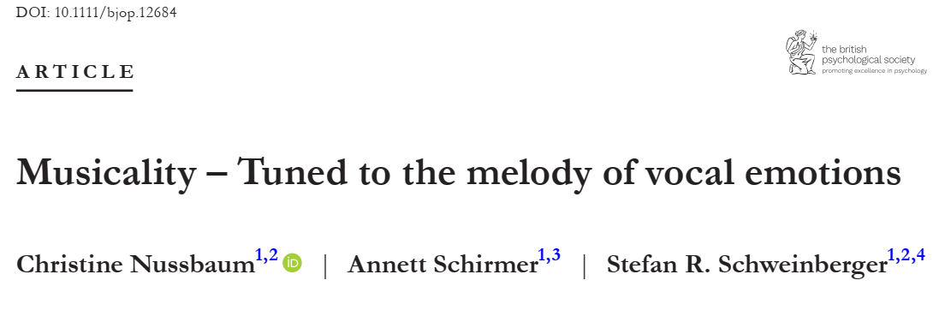
OG Study
Notes:
In previous research, musicality has been shown to benefit vocal emotion perception. This is likely due to an increased auditory sensitivity to acoustic cues, such as fundamental frequency (F0) and timbre, among musicians. However, it is unclear how musicians with different forms of engagement or different levels of expertise differ from each other in their use of these acoustic cues to infer emotional meaning from speech prosody.

Slide 3
OG & Follow-up study
Professionals | Non-musicians
N = 39 | N = 38
Behavioral & EEG data
Amateurs
Singers | Instrumentalists
N = 45 | N = 44
Only behavioral data

Slide 4
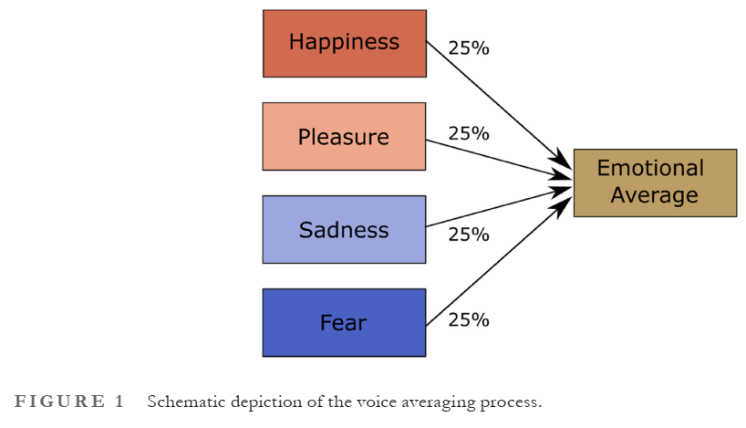
Vocal Emotion Classification - Stimuli
Nussbaum, Schirmer & Schweinberger, 2023

Slide 5
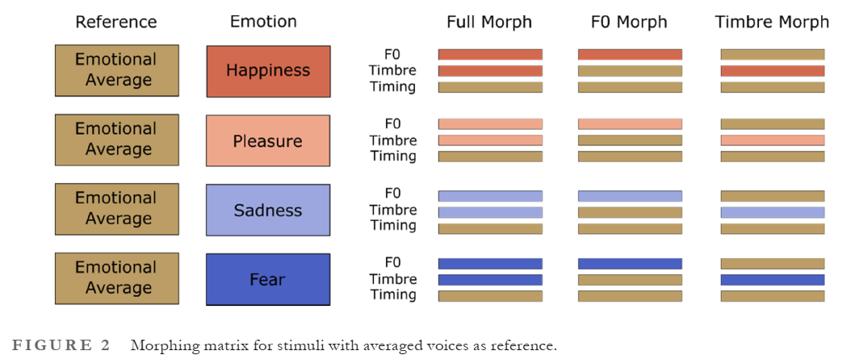
Vocal Emotion Classification - Stimuli
Nussbaum, Schirmer & Schweinberger, 2023

Slide 6
Musical Skills
Profile of Music Perception Skills (PROMS)
Subtests
Melody
Pitch
Rhythm
Timbre
Law & Zentner, 2012
Goldsmiths Musical Sophistication Index
(Gold-MSI)
Self-reported musical skills
Active Engagement
Formal education
Emotion
Singing
Perception
Müllensiefen et al., 2014

Slide 7

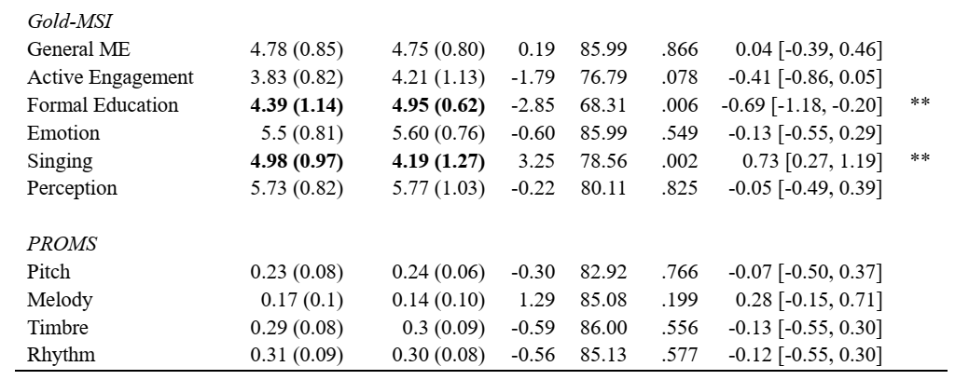
Results Musical Skills

Slide 8

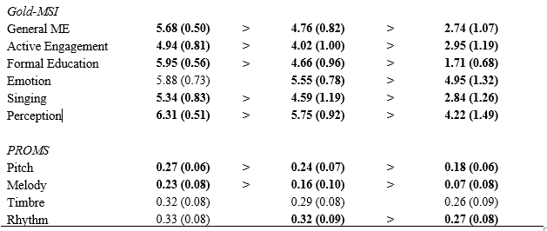
Results Musical Skills

Slide 9
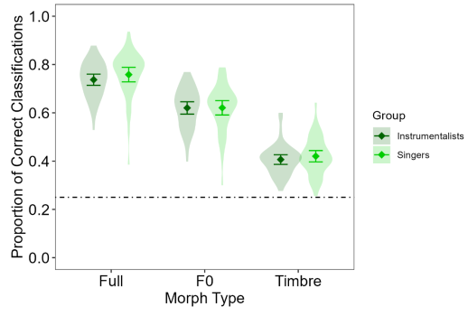
Results Vocal Emotion Classification
Notes:
Singers and instrumentalists did not significantly differ in their vocal emotion perception performance in any condition.

Slide 10
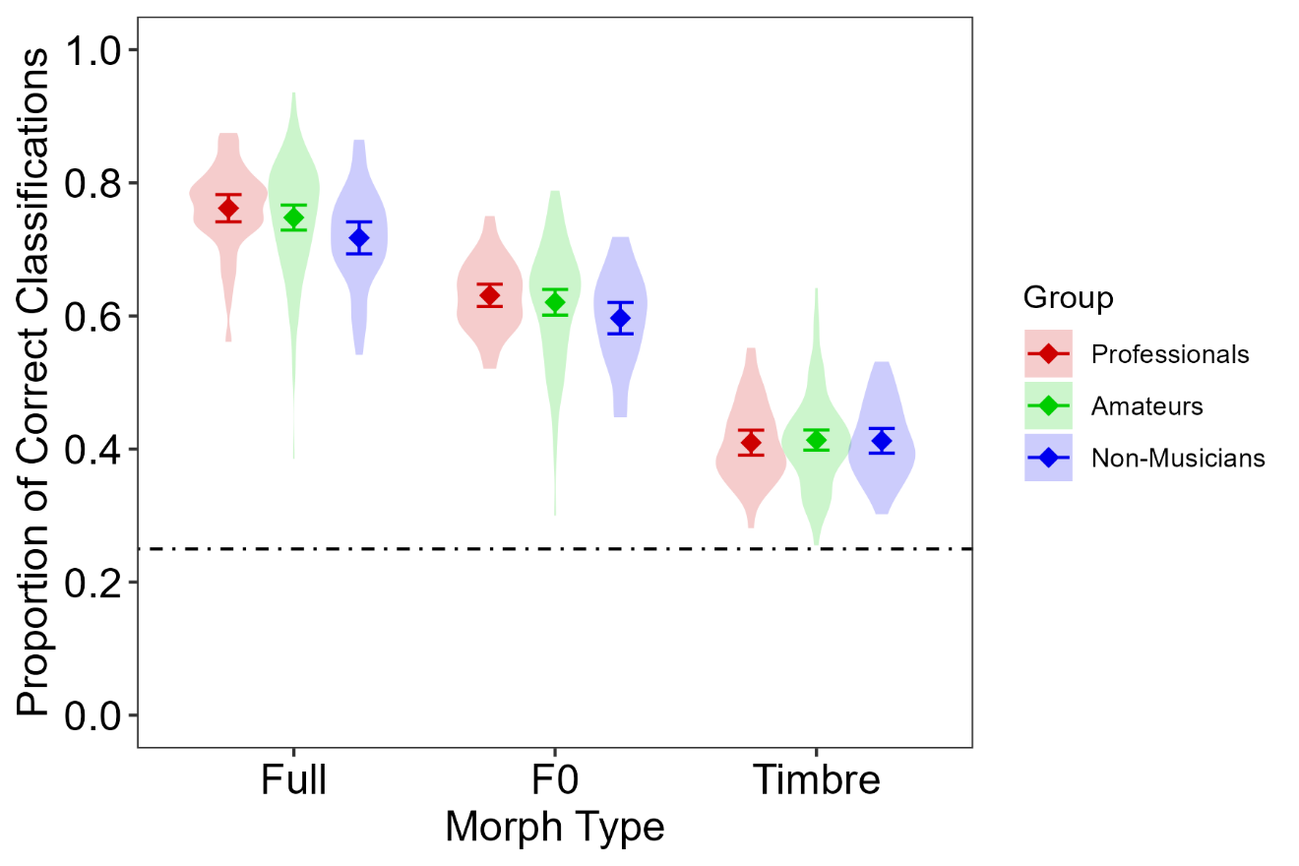
Results Vocal Emotion Classification
Notes:
amateurs
performed equally to professionals in full as well as F0- and timbre-modulated conditions
performed better than non-musicians in a condition with full emotion modulation, but not in an F0-modulated condition
In both these conditions, professionals outperformed non-musicians
There were no differences between the groups in a timbre-modulated condition.

Slide 11
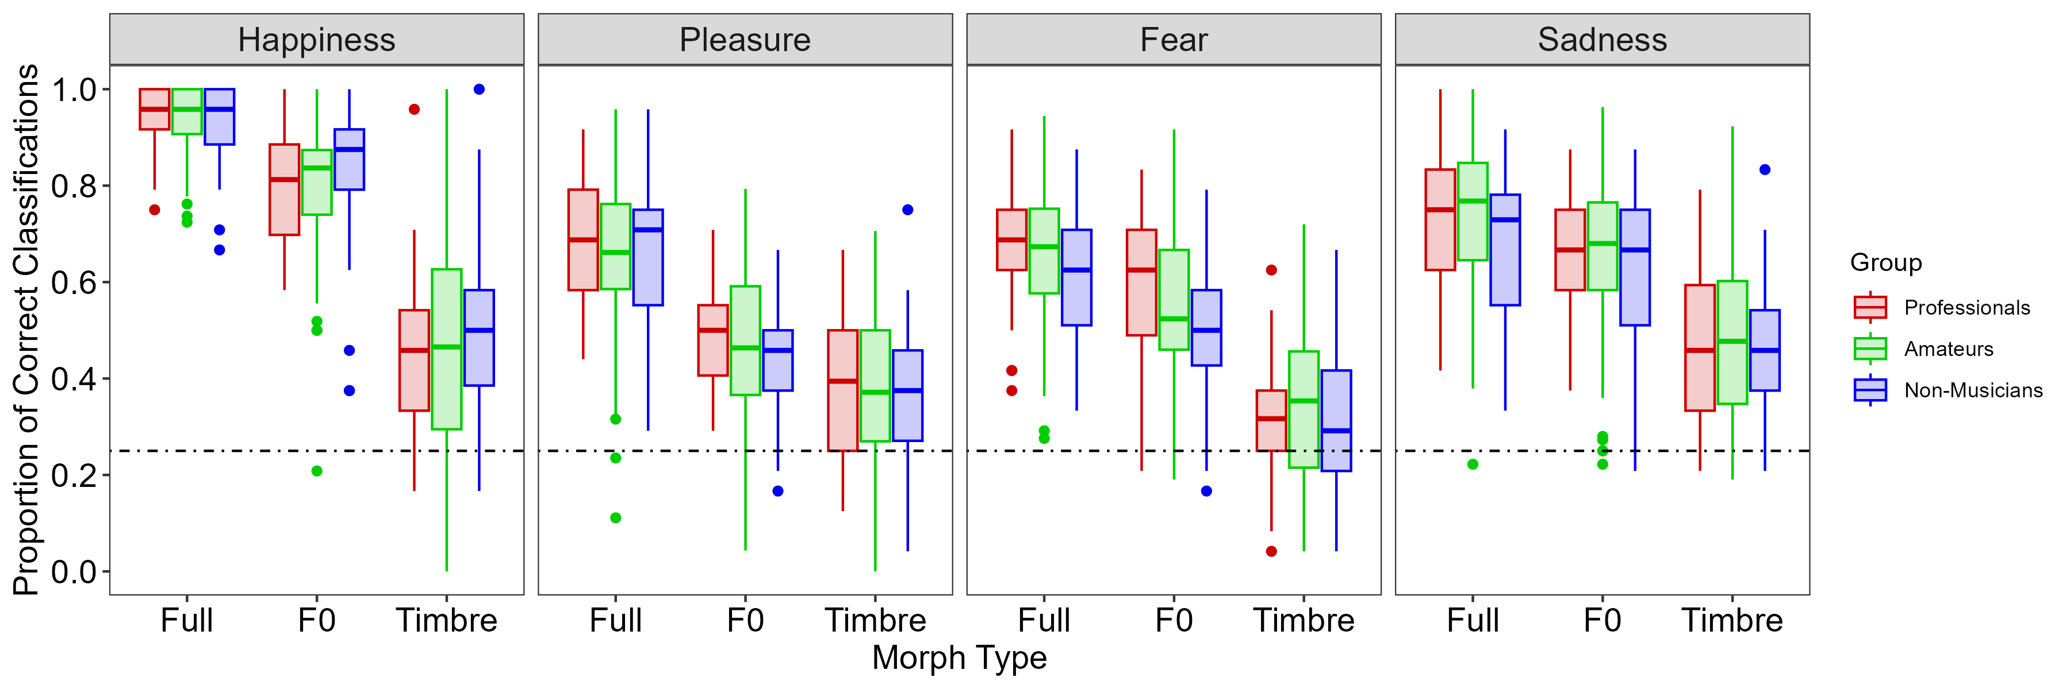
Results Vocal Emotion Classification

Slide 12
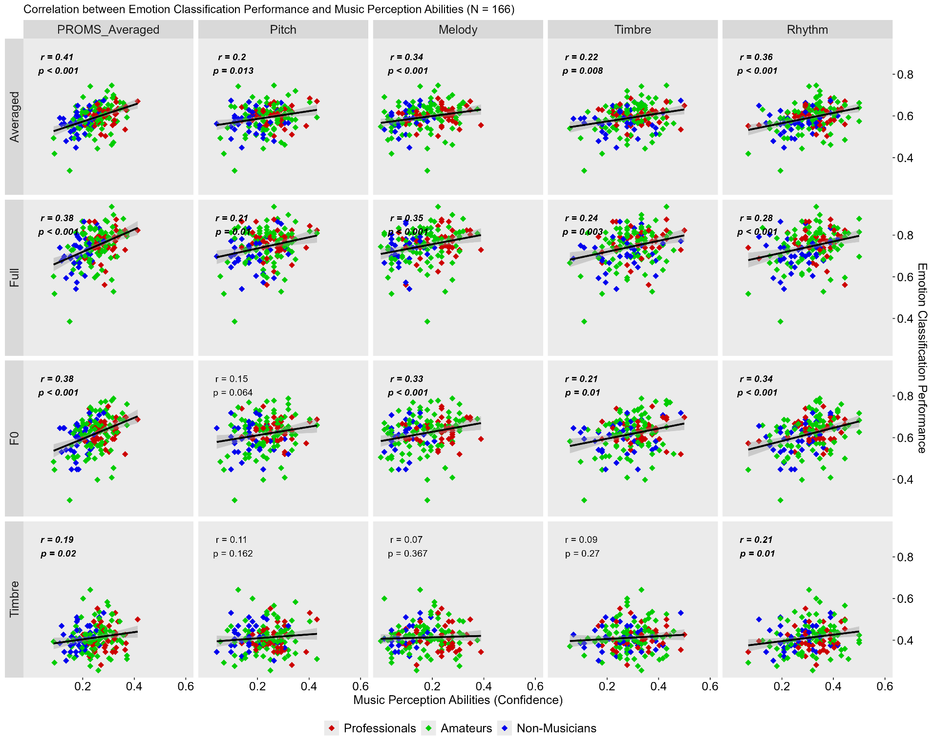
Results Exploratory correlations
Notes:
Additionally, exploratory analyses revealed a link between dynamic pitch perception in music and speech that remained when controlling for music training

Slide 13
Conclusions
musicality benefits vocal emotion perception
irrespective of different forms of musical engagement (singing vs. playing an instrument)
Irrespective of musical expertise (amateur vs. professional level)
Musicality and VER linked through naturally predisposed auditory sensitivity → particularly pitch contours
Notes:
These findings indicate that musicality benefits vocal emotion perception irrespective of different forms of musical engagement (singing vs. playing an instrument) or musical expertise (amateur vs. professional level).
Musicality and enhanced vocal emotion perception appear to be linked by a naturally predisposed auditory sensitivity that particularly concerns pitch contours.

Slide 14
Limitations & future directions
German speakers in Western music culture
„Ich habe den Eindruck, dass die Stimmlagen in Frankreich und Deutschland unterschiedlich wahrgenommen werden können. Ich frage mich also, ob es einen kulturellen Bias geben könnte?“
Amateur groups not strictly exclusive from each other
Stimuli
Stimuli with two-syllable pseudowords → One syllable? Sentences?
voice-morphing could reduce perceived naturalness of voices → but no effect on perception of vocal emotions (Nussbaum, Pöhlmann, et al., 2023)
Focus on pitch and timbre cues → timing and amplitude?

Slide 15
Thank you for your attention!

Slide 16
References
Literature
Nussbaum, C., Schirmer, A., & Schweinberger, S. R. (2023). Musicality – Tuned to the melody of vocal emotions. British Journal of Psychology, 00, 1–20. https://doi.org/10.1111/bjop.12684
Nussbaum, C., Pöhlmann, M., Kreysa, H., & Schweinberger, S. R. (2023). Perceived Naturalness of Emotional Voice Morphs. Cognition And, 37(4), 721–747.
Law, L. N. C., & Zentner, M. (2012). Assessing Musical Abilities Objectively: Construction and Validation of the Profile of Music Perception Skills. PLOS ONE, 7(12), 1–15. https://doi.org/10.1371/journal.pone.0052508
Müllensiefen, D., Gingras, B., Musil, J., & Stewart, L. (2014). The Musicality of Non-Musicians: An Index for Assessing Musical Sophistication in the General Population. PLOS ONE, 9(2), 1–23. https://doi.org/10.1371/journal.pone.0089642

